Slide 1



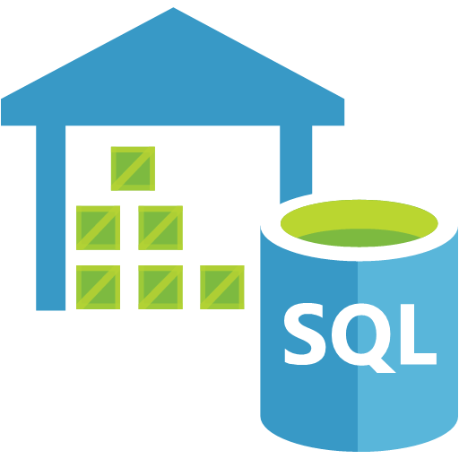


Option 2 – Offload Analytics to ADL
Data Extract
Copy Files
Polybase
Flat File
Azure Blob Storage
Azure SQLDW
Netezza
DDL Extract
DDL/Load
DDL File
Converted DDL
Netezza DDL
Netezza DDL Converter
Converted DDL/Load Routine
Data Migration Jumpstart Engineering Team

